Slide 1

Global Energy
Christopher Swires
Huseyin Teyfur
Saloum Bouchaaya
Jay Boon
Chritopher Alvizures

Slide 2

Build a better tomorrow
Which energy source will have the biggest impact on our future: renewable sources, or traditional sources?

Slide 3

Let’s think about…
Countries & Continents energy consumption
Energy consumption change over time
Energy sources used
Where to go from here

Slide 4

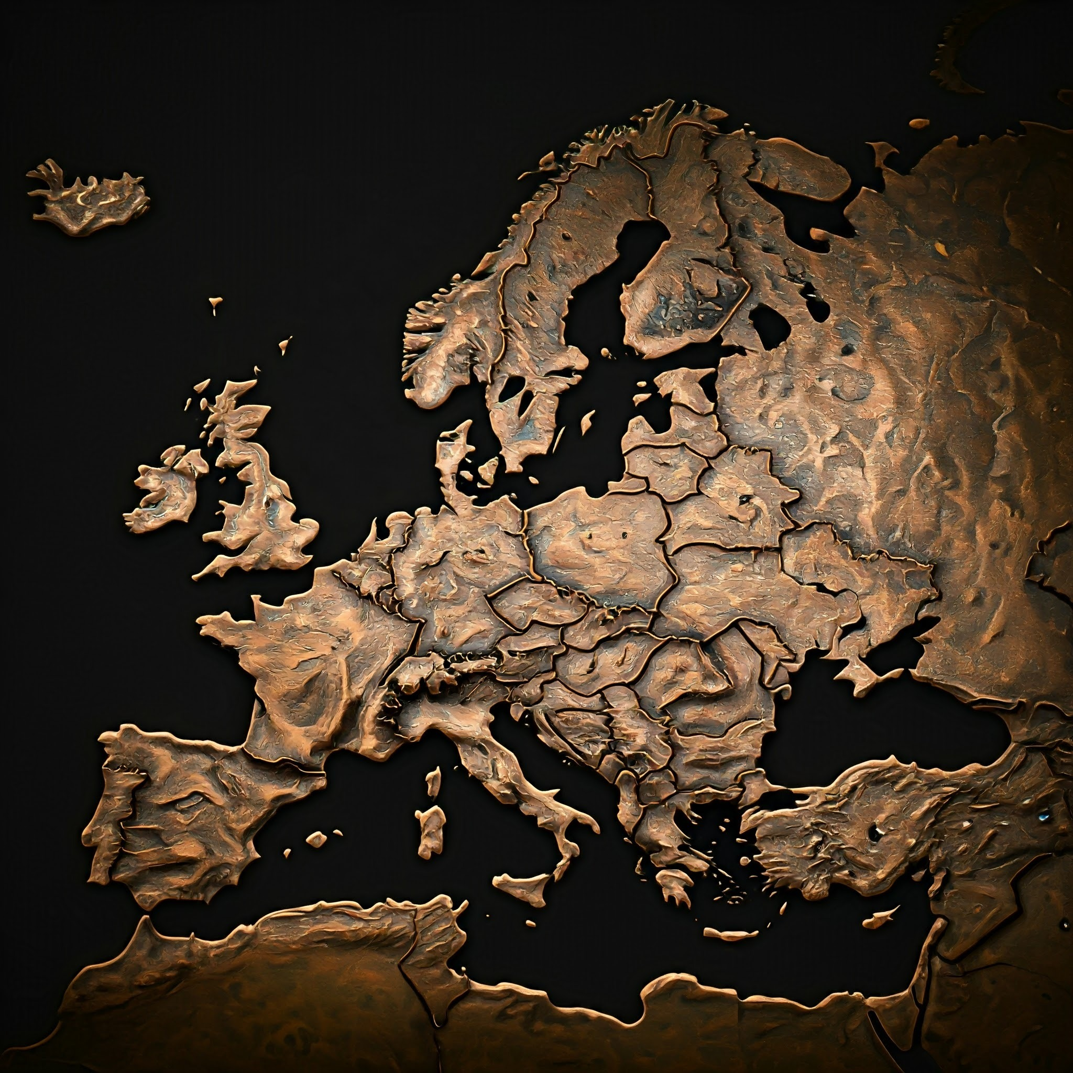


Dive into Data
219 Countries
6 Continents
7 Energy Resources
Consumption Per Capita
Consumption Per Energy Source
Total Energy Use

Slide 5
Energy Sources around the world
Biofuel
Coal
Gas
Hydro
Oil
Solar
Wind

Slide 6
Slides Data Frames

Slide 7
Slides Data Frame

Slide 8
Slides DataFrame

Slide 9
Slides DataFrame

Slide 10
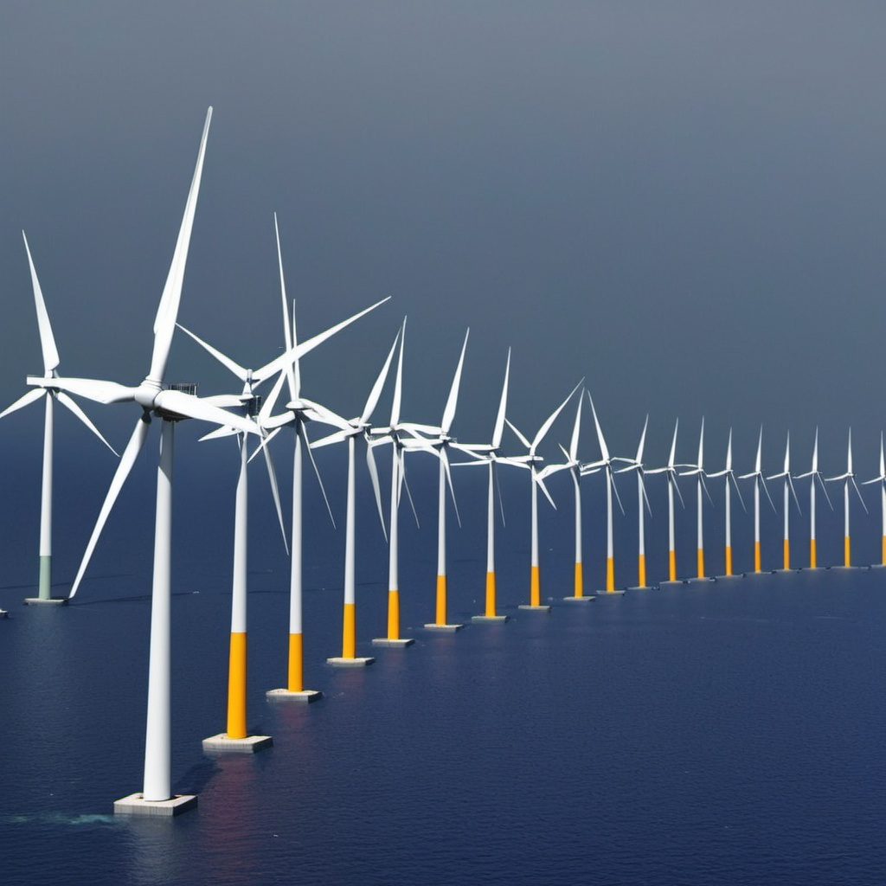
Key Take Aways:
X was main energy source from 2010-2022
We saw dramatic change in energy use from 20xx-20xx
Energy globally….

Slide 11

Looking Forward
Moving forward we recommend an more use of xyz
Globally we must decrease xyz consumotion
XY continent should ….

Slide 12
Data sources:
Credit
Jackjaehwankim
https://www.kaggle.com/code/jackjaehwankim/which-countries-use-fossil-fuel-most
Framed, Charted, & Presented by:
Christopher Swires
Huseyin Teyfur
Saloum Bouchaaya
Jay Boon
Chritopher Alvizures

